Slide 1
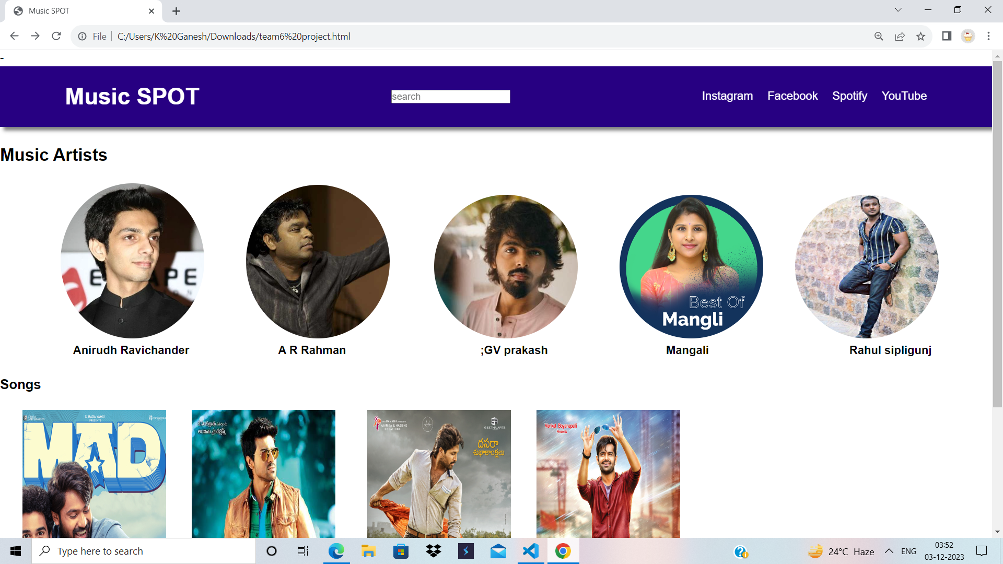
Music Streaming Service Homepage
By using HTML and CSS

Slide 2

What is Music streaming service ?
A music streaming service is a web based service that allows users to stream music to their
Moblie devices or computers .like Spotify etc…….

Slide 3
About the homepage
Link bar
Search bar
Music arties with links
songs

Slide 4
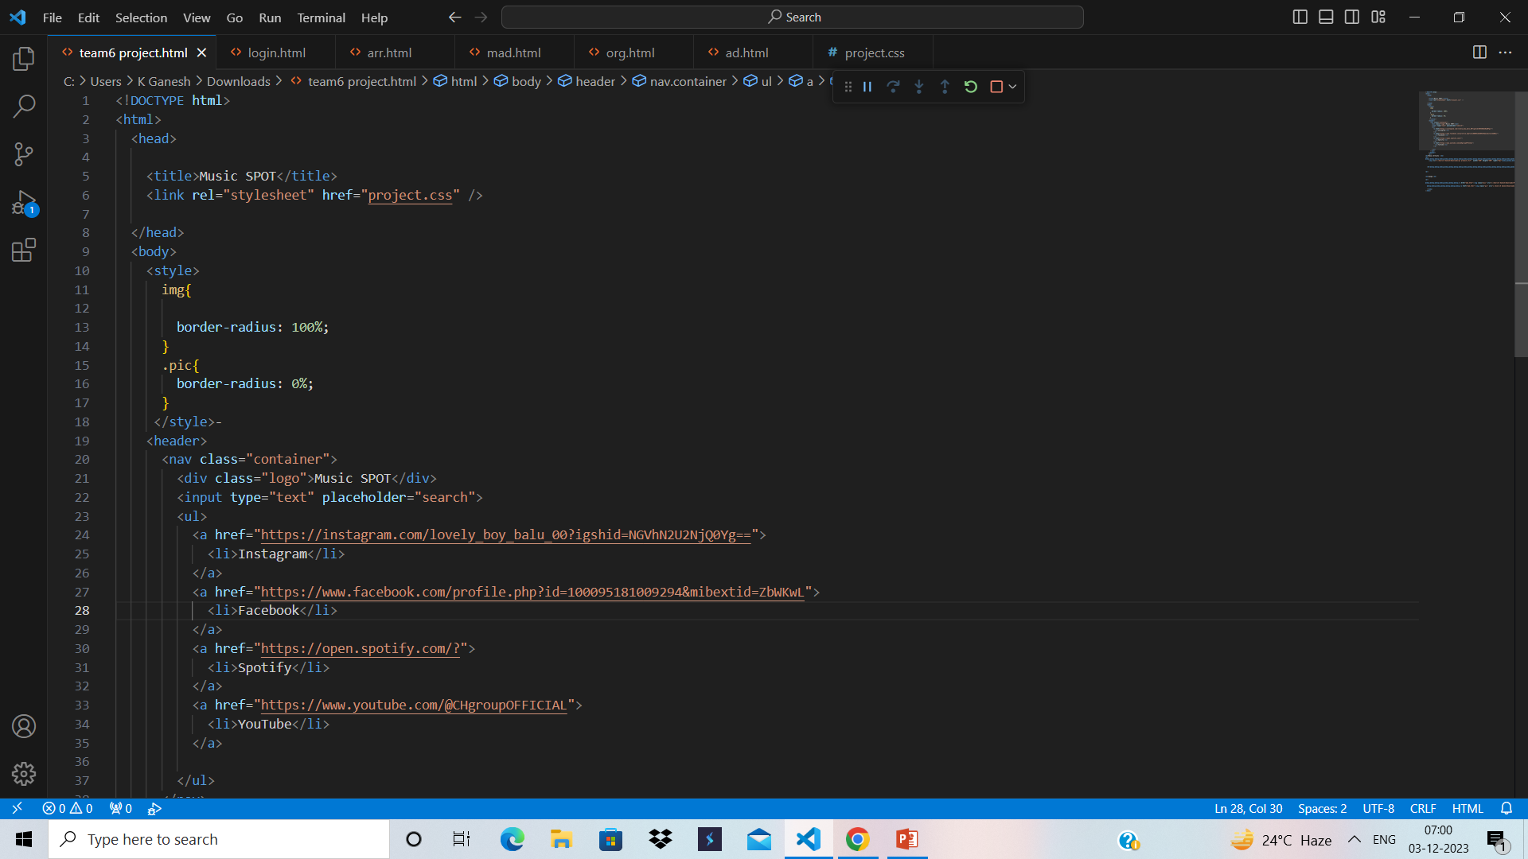
HTML TAGS what are used
HTML TAGS are used
<html>
<head>
<header>
<title>
<body>
<nav>
<a>
<img>
<li>
<h>
&nbsp
<a href=“>
<br>
<button>
<style>
<source>
<audio>

Slide 5
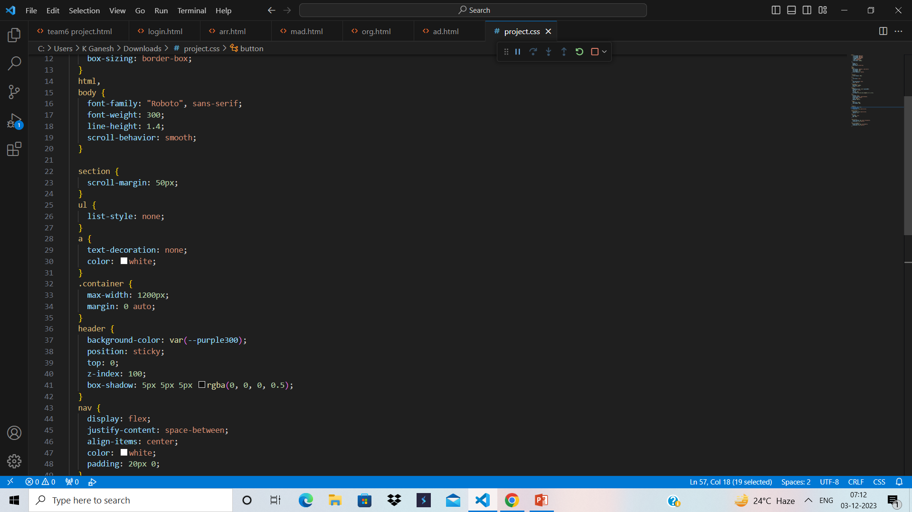
CSS
CSS Is used in
Body
Nav
Header
Logo
Button

Slide 6
AID TEAM 6
PROJECT :-Music streaming service homepage.
MEMBERS :- Abhi.
Eswar.
Balu.
Jithin.
Manikanta.
Venkat
Ramesh.
Vinay.
….END….

